Slide 1
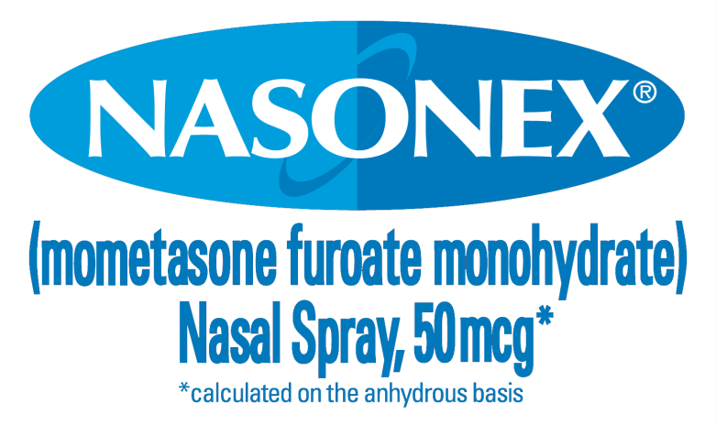
Nasonex 2011 Year in Review Business Impact Report
Notes:
1

Slide 2
Purpose and Agenda
Review Full Year 2011 eMarketing performance
Review 2011 events that influenced eMarketing returns
Discuss key opportunities for optimizing eMarketing business impact in 2012
2
CONFIDENTIAL – MERCK ONLY

Slide 3

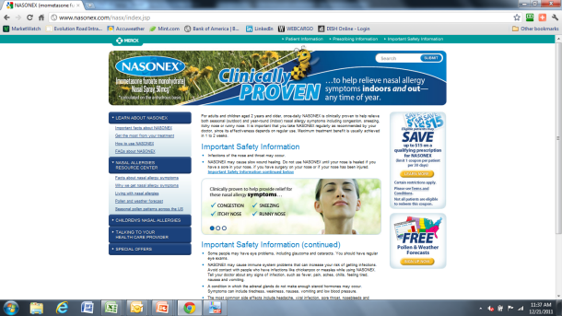
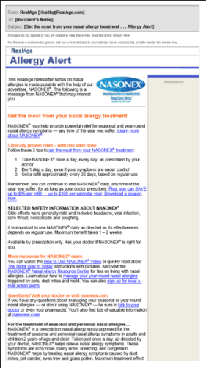


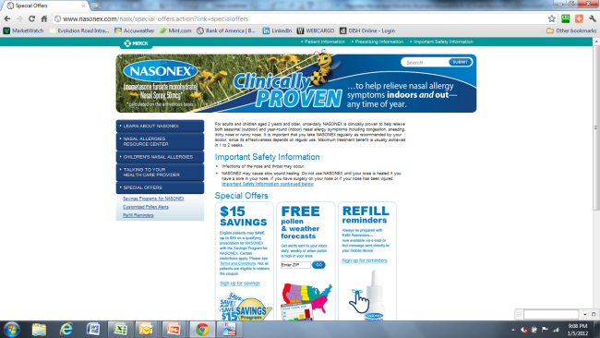
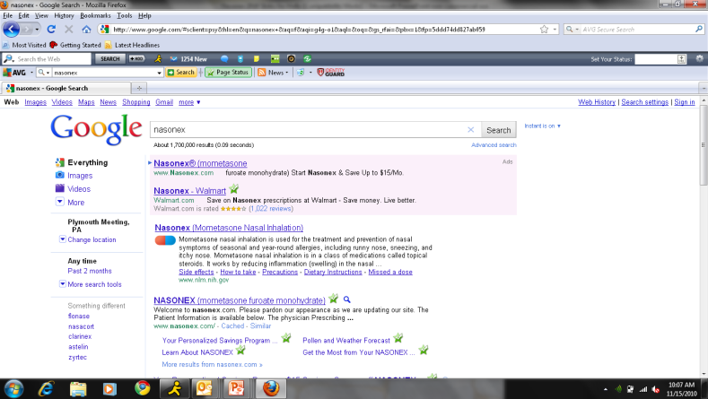
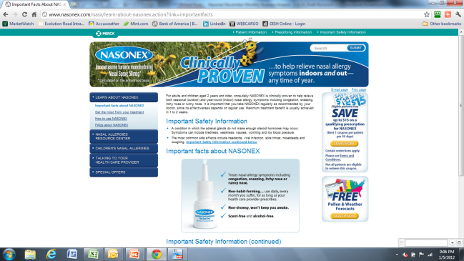
Nasonex 2011 eMarketing Focus – Drive New Patient Starts While Maintaining Incremental Refills
Primary Goal- 60%
Drive new patient starts
Secondary Goal- 40%
Drive incremental refills from existing Nasonex users
Promotional Banners
Nasonex.com Consumer Website
Home Page
Real Age
Coupon Page
Multiple Pages Including Coupon Pages
Paid Search
CONFIDENTIAL – MERCK ONLY

Slide 4
Key Highlights
2011 Full Year Projected to Deliver $22M+ at 2.7+ ROI
Full year ROI numbers updated in September based on changes to methodology and patient value
Updates based on lower value of patients (vs. prospects) and incremental retention value from coupons
Paid Search delivered 11% over ROI goal at 4.0:1
Campaign optimizations resulted in 10% greater efficiency
Display delivered 50% below ROI goal at 1.2:1
Coupon redemptions significantly below projections
Campaign UVs cost 14% above goal
Real Age projected to deliver 4.5+ ROI
Moderately below 5.3 ROI goal
HealthiNation below breakeven
CONFIDENTIAL – MERCK ONLY

Slide 5
Nasonex 2011 eMarketing Performance
CONFIDENTIAL – MERCK ONLY

Slide 6
Important Notes About Analysis
2011 projections for conversion and retention are based on:
Qualification and patient/prospect split from 2011 eROI study Wave 1 launched in September 2011 (small samples)
Conversion rate from Oct 2010 ComScore study
Possible declines in overall conversion due to early-2011 changes in the website design have been factored into ROIs
Updated conversion not available on current site design
Updates to patient values (new patient start, retention, and value of 1 Rx) methodology updated in August 2011
Change in methodology has had a significant impact on projected ROI
CONFIDENTIAL – MERCK ONLY

Slide 7
2011 Full Year Nasonex eMarketing Projected to Deliver $21M+ at 2.6+ ROI
eMarketing Tactic | Spend ($MM) |  |  | Incremental Rev. ($MM) |  |  | ROI
 | Actual 2011 | Full Year Goal | % to Plan | Actual 2011 | Full Year Goal | % to Plan | Actual 2011 | Full Year Goal | % to Plan
TOTAL | $8.2 | $8.3 | 99% | $22.0 | $27.6 | 80% | 2.7 | 3.3 | 80%
Paid Search | $2.6 | $2.6 | 100% | $10.3 | $9.3 | 111% | 4.0 | 3.6 | 111%
Display | $4.1 | $4.2 | 98% | $4.8 | $10.3 | 47% | 1.2 | 2.5 | 48%
Real Age | $1.5 | $1.5 | 100% | $6.8 | $8.0 | 85% | 4.5 | 5.3 | 86%
Overall performance driven by Real Age and Paid Search
Paid search performing above plan
Display Campaign performance metrics are positive
Full-year goals set based on 2010 ROI projection methodology
ROI projections significantly decreased due to revised methodology and patient values
Streamlining coupon download can bring ROI up to 2.5+
Real Age projections reduced to 4.5:1 based on reporting of patient/ prospect split in Acquisition programs in ROI studies
CONFIDENTIAL – MERCK ONLY
Notes:
7

Slide 8
2011 Nasonex Paid Search Performed Above 2011 Goal at 4:1 ROI and $10.1M Incremental Revenue
Paid search was an effective and efficient channel for Nasonex in 2011
Efficient - YTD $3.10 vs. $3.44 FY CPUV Goal
Effective - 83% of clicks are unique visitors
Google Content Network ads drive traffic to Nasonex.com efficiently but with low engagement
Engagement metrics (2+ PV, CP2+) below campaign average
Content Network activity was paused on 11/18.
Performance against 2+ engagement metrics below goal
Testing in 2012 if running Display banner (vs. text ad) on Content Network drives a more engaged user to the site.
Mobile search extremely efficient at $2.21 CPUV (vs. $3.10)
Even though site is not mobile optimized %2+PV is still very good (18% for mobile vs. 22% for desktop)
Quality and conversion undetermined for mobile search
Coupon download not available through mobile
8
CONFIDENTIAL – MERCK ONLY

Slide 9
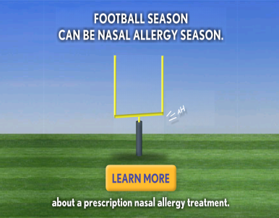
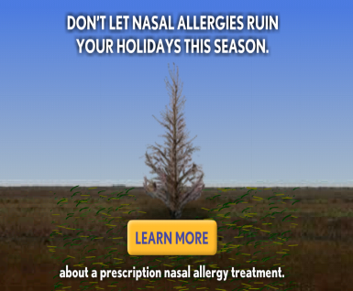
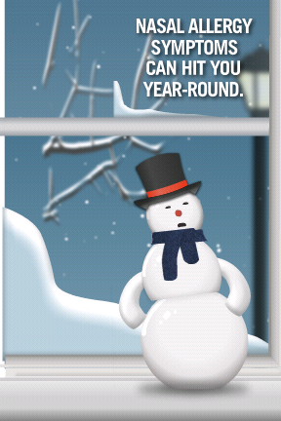
2011 Nasonex Display ROI Projected at 1.2:1 CUPV Behind Goals at $6.53 (vs. $5.76)
Performance has improved with introduction of new creative
Unbranded CTR at 3x branded with significantly more efficient CPUV and CP3+
Unbranded %3+PV (engagement KPI) is lower (3.6% vs. 5.3%)
ROI projected at 1.2:1
2% of Display UVs download coupons
Coupons drive Nasonex retention
Winter-themed creative now in rotation
Goal Post and Tree live 10/28;
Snowman (non-rebate) live 11/7
9
CONFIDENTIAL – MERCK ONLY

Slide 10
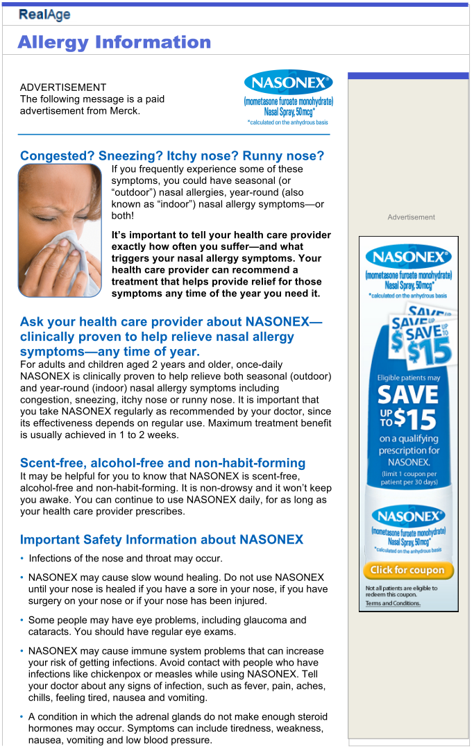
Nasonex Real Age 2011 Projected to Deliver $6.75M Incremental Revenue at 4.5:1 ROI
Nasonex Real Age 2011 campaigns
$1.5MM at $1.00 cost per participant
ROI of 4.5:1 for 628k (42%) reported to date
ROI reporting only on late spring programs (5/10-6/7/2011)
Acquisition Program (S19) delivers $1.8M incremental at 5.5:1 ROI
328k participants
41% of leads were Nasonex patients
Follow-up program (S4) delivers $1.0M incremental at 3.4:1 ROI
300k participants
83% of leads were Nasonex patients
10
CONFIDENTIAL – MERCK ONLY

Slide 11
2011 Optimizations
Jan
Feb
March
April
May
June
July
Aug
Sept
Oct
Nov
Dec
4
BT replanning recommendation implemented
(4/26 – 9/30)
6
Fall heavy-up begins on optimized site list (8/1)
12
“Baseball” removed, fall heavy-up concluded (10/31)
2
$1MM incremental implemented (3/22 – 3/30)
9
“Pumpkin”added (10/14)
Display campaign launched 2/25
5
8
13
“Tree” “snowman” added, “pumpkin” “scarecrow” removed
(11/14, 11/30)
1
Spring heavy-up ends; Quadrant One canceled due to poor performance
“Baseball” unbranded banners in rotation with coupon creative
(8/17)
“Goalpost” creative in rotation
(9/7)
7
14
Merck halts all behaviorally-targeted placements
10
3
“Scarecrow” added
(10/17, 10/24)
11
Campaign begins, utilizing optimized site list from 2010 plan (Razorfish/DFCB)
DFCB implements $1MM in incremental utilizing top performers as well as several test partners and placements
All behaviorally-targeted placements removed from plan post-Q1
Dollars from behavioral targeting re-planned, allocated among top performers and several test partners
Spring heavy-up concludes, vendor list shortens for June-July period
Fall heavy-up resumes with top performers from Spring as well as BT replanning test partners running coupon creative only
As of August 17, new unbranded banners running “Baseball” in 100% rotation on 728x90 and 300x250 placements
As of September 7, “goalpost” unbranded banners added in 50/50 rotation with “baseball” on 728x90 and 300x250 placements
As of October 14, “pumpkin” unbranded banners added in 33/33/33 rotation with “baseball” and “goalpost” on 728x90 and 300x250 placements (branded coupon banners on 160x600 and 300x600)
As of October 17, “scarecrow” branded banners added in 50/50 rotation (rebate/non-rebate) on 300x600 placements
As of October 24, “scarecrow” branded banners added in 100% rotation on 160x600 placements
As of October 31, “baseball” unbranded banners removed from rotation, “goalpost” and “pumpkin” at 50/50 rotation; fall heavy-up concludes
As of November 14, “tree” unbranded banners and “snowman” branded banners (non-rebate only) in even rotation
As of November 30, “pumpkin” unbranded banners and “scarecrow” branded banners removed from rotation, remaining banners in even rotation Tree, Snowman, Goalpost
Display campaign ends 12/31
11

Slide 12

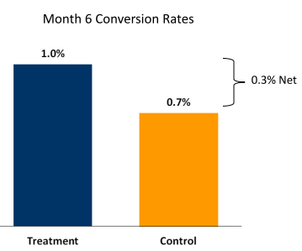
HealthiNation ROI Below Breakeven
Nasonex commercial ran in videos with allergies content
Campaign ran 3/11 - 6/11
Campaign reached 152,428 viewers
HealthiNation delivered 0.2:1 ROI
Program budget $365k
454 incremental new patients
$65k incremental revenue

Slide 13
Nasonex 2011 eMarketing Considerations and Opportunities
Changes in patient value and methodology
Improving usability of online coupon
Optimizing Nasonex.com
CONFIDENTIAL – MERCK ONLY

Slide 14



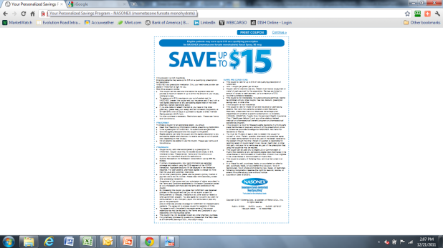
Changes in Patient Value and Methodology Emphasize Importance of Coupons on Nasonex Retention
August 2011 and Earlier
Patient
Lift Above Control
Patient
Retention Value (2.9+ Incremental Rx)
Incremental Retention Revenue
X
=
Patients
Prospect
Lift Above Control
Lifetime Patient Value
Incremental Prospect Revenue
X
=
Prospects
September 2011 +
Patient
Lift Above Control
Value of 1Rx
Incremental Script Revenue
X
=
Patients
Incremental Retention Revenue
Multi-use Coupon or RM program
Retention Value (1.9+ Incremental Rx)
X
=
Prospect
Lift Above Control
Lifetime Patient Value
Incremental Prospect Revenue
X
=
Prospects

Slide 15



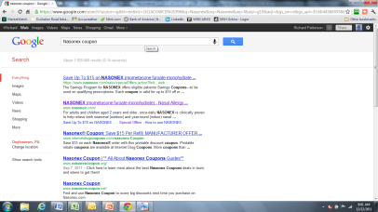
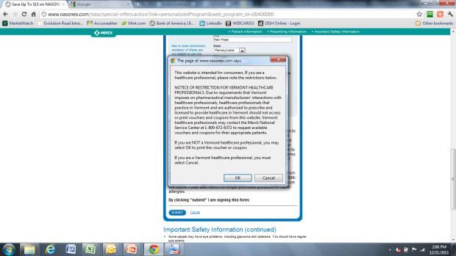
Emphasizing Coupon Use Over RM Enrollment Can Improve User Experience and Coupon Utilization
Media-driven visitors expect immediate coupon
Requiring RM form delivers suboptimal user experience, causing bounce
622k UVs
2,539k Unique Visitors
1.187k (47%) Coupon Page Views
Display
44% patients
844k UVs
Paid Search
37% patients
1,074 UVs
Landing Pages
Coupon Page
Organic
RM Form
79% patients
392k (15%) Coupon Prints
Only 1/3 of Total Visitors Print the Coupon
Rates are much lower for display- and search-driven visitors
11k (2%)
65k (8%)
316k (29%)
Coupon Print
Interstitial Disclaimer

Slide 16
Display ROI Can Increase from 1.2+ to 2.5+ by Streamlining Coupon Download
Display drives $4.9M+ incremental at 1.2+ ROI at current download and redemption rate
1.2+ ROI
$4.0M YTD Display Spend
622k Unique Visitors
11k Coupons Redeemed
$4.9M Incremental Revenue
Simplifying coupon process could drive ROI to 2.5+ if coupon downloads are similar to Singulair
2.5+ ROI
$4.0M YTD Display Spend
612k Unique Visitors
57k (+ 11k) Coupons Redeemed
$10.1M (+1.5M) Incremental Revenue
* Jun-Dec actual reported on dashboard, Jan-May projected based on average print and redemption rate for Jun-Dec.

Slide 17
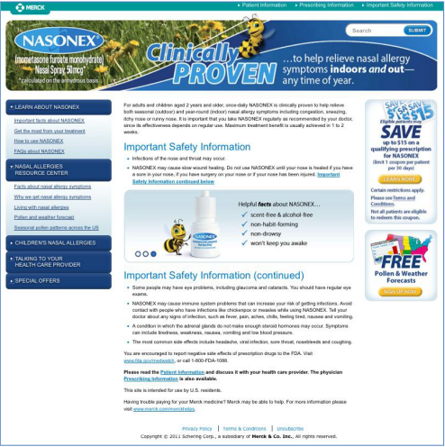

Optimize Nasonex.com to Increase Conversion and Retention Rates
Declines in engagement due to regulatory-driven design changes implemented Feb ‘11
Floating fair balance
Loss of “Powerful Relief”
“Quick fix” changes implemented in May did not improve visitor engagement
Revised website in development by legacy agency (Daggerwing)
Streamlined coupon process submitted and PRT approved in Dec.
Updated recommendations for site optimization and creative campaign alignment to be presented in Jan 2012
Updated website scheduled to deploy in time for Spring 2012 allergy peak
CONFIDENTIAL – MERCK ONLY

Slide 18
Conclusions and Implications for 2012
Further improvements in ROI can result from optimization by pairing qualification, patient/prospect split, and intent data (from eROI Wave 1 survey) with effectiveness (unique visits), efficiency (CPUV), and engagement (coupon downloads, 3+PV)
Paid search is the most efficient effective driver of qualified traffic to Nasonex.com and is performing ahead of goal
Display, with media highly optimized in 2011, delivered marginal ROI
Website redesign and optimization of coupon process should improve ROI delivered through paid media
Goals for 2012 to be determined based on patient/prospect split and creative performance
Recommend re-evaluating display following site redesign
Real Age remains a significant driver of incremental revenue at 4.5+ ROI
ROI performance contingent on continued cost of $1 per participant
Programs would perform at breakeven at standard cost of $3.50+ per participant
18
CONFIDENTIAL – MERCK ONLY

